Slide 1
Agenda
Paycheck Protection Program
EIDL Grant & PPP
Who is eligible
Loan amount
What are “payroll costs”?
Permitted uses of proceeds
Loan forgiveness provisions
Documentation
Miscellaneous items

Slide 2
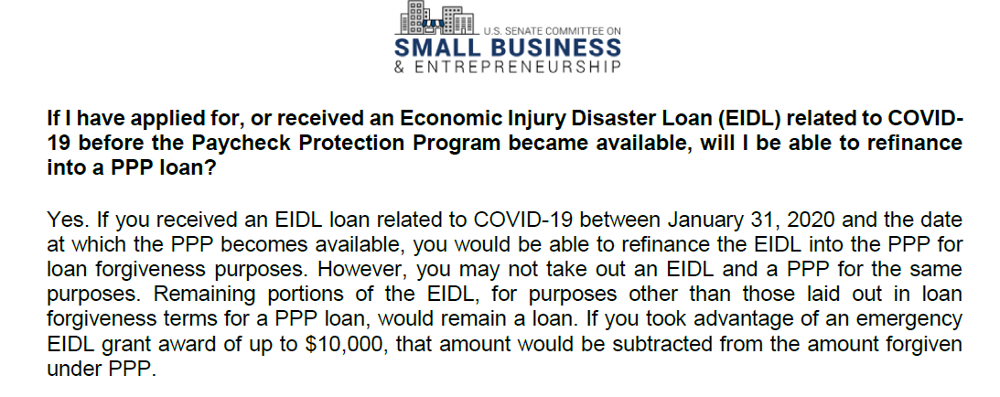
EIDL $10,000 Grant & PPP

Slide 3
Economic Injury Disaster Loans
Overview - Business Eligibility
EIDLs allow small businesses, tribal businesses, cooperatives, ESOPs, non-profits, sole proprietors and contractors with fewer than 500 employees that are impacted by COVID-19 to receive loans up to $2mm to pay debts, make payroll and meet other expenses −In addition, CARES created new “Emergency Grants” of up to $10k available to EIDL applicants that are disbursed within 3 days and are not required to be repaid
EIDL loans can be applied for directly with the SBA at https://disasterloan.sba.gov/ela/
Borrowers can receive up to a $10,000 grant within 3 days after applying for an EIDL loan
If the application is denied, the applicant is not required to repay the grant
Businesses with less than 500 employees or, if more lenient, meeting the SBA small business definition outlined in the prior PPP section, operating since January 31st, 2020
Do not need to demonstrate that credit is otherwise unavailable to the borrower
Interest and Fees
3.75% for small businesses and 2.75% for non-profits
Borrowers will not be charged any participation fees or prepayment fees
Guarantees and Collateral
Guarantees are required for loans >$200k and collateral is required if loan is >$25kReal estate is preferred, but a loan will not be declined for lack of collateral. Any available collateral will be taken. SBA lien is subordinate to any existing liens
Emergency Grants
Borrowers can receive up to a $10,000 grant within 3 days after applying for an EIDL loan
If the application is denied, the applicant is not required to repay the grant

Slide 5
Maximum Loan Amount
 | Past 12 Months | Average Monthly
Enter the total cost of the past 12 months in the yellow boxes
Payroll Costs:*
Salaries, wages, commissions, vacation and sick pay (not to exceed $100K
per employee) other than qualified sick or family leave |  | $ -
Group Health Insurance | $ - | $ -
Retirement Benefit Costs | $ - | $ -
State/Local Taxes on Employee Compensation (i.e., employer U.C. tax) | $ - | $ -
Self-Employed Income (and subcontractors) not to exceed $100K per year
per self-employed prorated for the period February 15, 2020 to June 30, 2020 | $ - | $ -
Total Average Monthy Payroll Costs |  | $ -
SBA Multiplier |  | 2.5
Maximum Loan Amount | a) | $ -
MAXIMUM LOAN AMOUNT [Lesser of a) or $10 million] | b) | $ -
Allowable Uses of Funds During the Period February 15, 2020 to June 30, 2020:
1) Payroll costs (defined above)
2) Health care benefits (including group health insurance)
3) Interest on mortgages (not principal)
4) Rent (including rent under a lease agreement)
5) Utilities
6) Interest on any other debt obligations that were incurred before the covered period (February 15, 2020).
* For use in estimating maximum loan amount - Informational purposes only

Slide 6
Maximum Loan Amount Seasonal Business
 | 2/15/2019-6/30/2019 | Average Monthly
Enter the total cost for the period 2-15-2019 to 6-30-2019 in the yellow boxes
Payroll Costs:*
Salaries, wages, commissions, vacation and sick pay (not to exceed $100K
per employee) other than qualified sick or family leave | $ - | $ -
Group Health Insurance | $ - | $ -
Retirement Benefit Costs | $ - | $ -
State/Local Taxes on Employee Compensation (i.e., employer U.C. tax) | $ - | $ -
Self-Employed Income (and subcontractors) not to exceed $100K per year
per self-employed prorated for the period February 15, 2020 to June 30, 2020 | $ - | $ -
Total Average Monthy Payroll Costs |  | $ -
SBA Multiplier |  | 2.5
Maximum Loan Amount | a) | $ -
MAXIMUM LOAN AMOUNT [Lesser of a) or $10 million] | b) | $ -
Allowable Uses of Funds During the Period February 15, 2020 to June 30, 2020:
1) Payroll costs (defined above)
2) Health care benefits (including group health insurance)
3) Interest on mortgages (not principal)
4) Rent (including rent under a lease agreement)
5) Utilities
6) Interest on any other debt obligations that were incurred before the covered period (February 15, 2020).
* For use in estimating maximum loan amount - Informational purposes only

Slide 7
Maximum Loan Amount New Business
 | January - February 2020 | January - February 2020 | Average Monthly
Enter the total cost for the period 01-01-2020 to 02-29-2020 in the yellow boxes
Payroll Costs:*
Salaries, wages, commissions, vacation and sick pay (not to exceed $100K
per employee) other than qualified sick or family leave | $ - | $ - | $ -
Group Health Insurance | $ - | $ - | $ -
Retirement Benefit Costs | $ - | $ - | $ -
State/Local Taxes on Employee Compensation (i.e., employer U.C. tax) | $ - | $ - | $ -
Self-Employed Income (and subcontractors) not to exceed $100K per year
per self-employed prorated for the period February 15, 2020 to June 30, 2020 | $ - | $ - | $ -
Total Average Monthy Payroll Costs |  |  | $ -
SBA Multiplier |  |  | 2.5
Maximum Loan Amount | a) | a) | $ -
MAXIMUM LOAN AMOUNT [Lesser of a) or $10 million] | b) | b) | $ -
Allowable Uses of Funds During the Period February 15, 2020 to June 30, 2020:
1) Payroll costs (defined above)
2) Health care benefits (including group health insurance)
3) Interest on mortgages (not principal)
4) Rent (including rent under a lease agreement)
5) Utilities
6) Interest on any other debt obligations that were incurred before the covered period (February 15, 2020).
* For use in estimating maximum loan amount - Informational purposes only

Slide 8
Questions
Thank You!
Clay Price & Associates, P.A.

